Slide 1
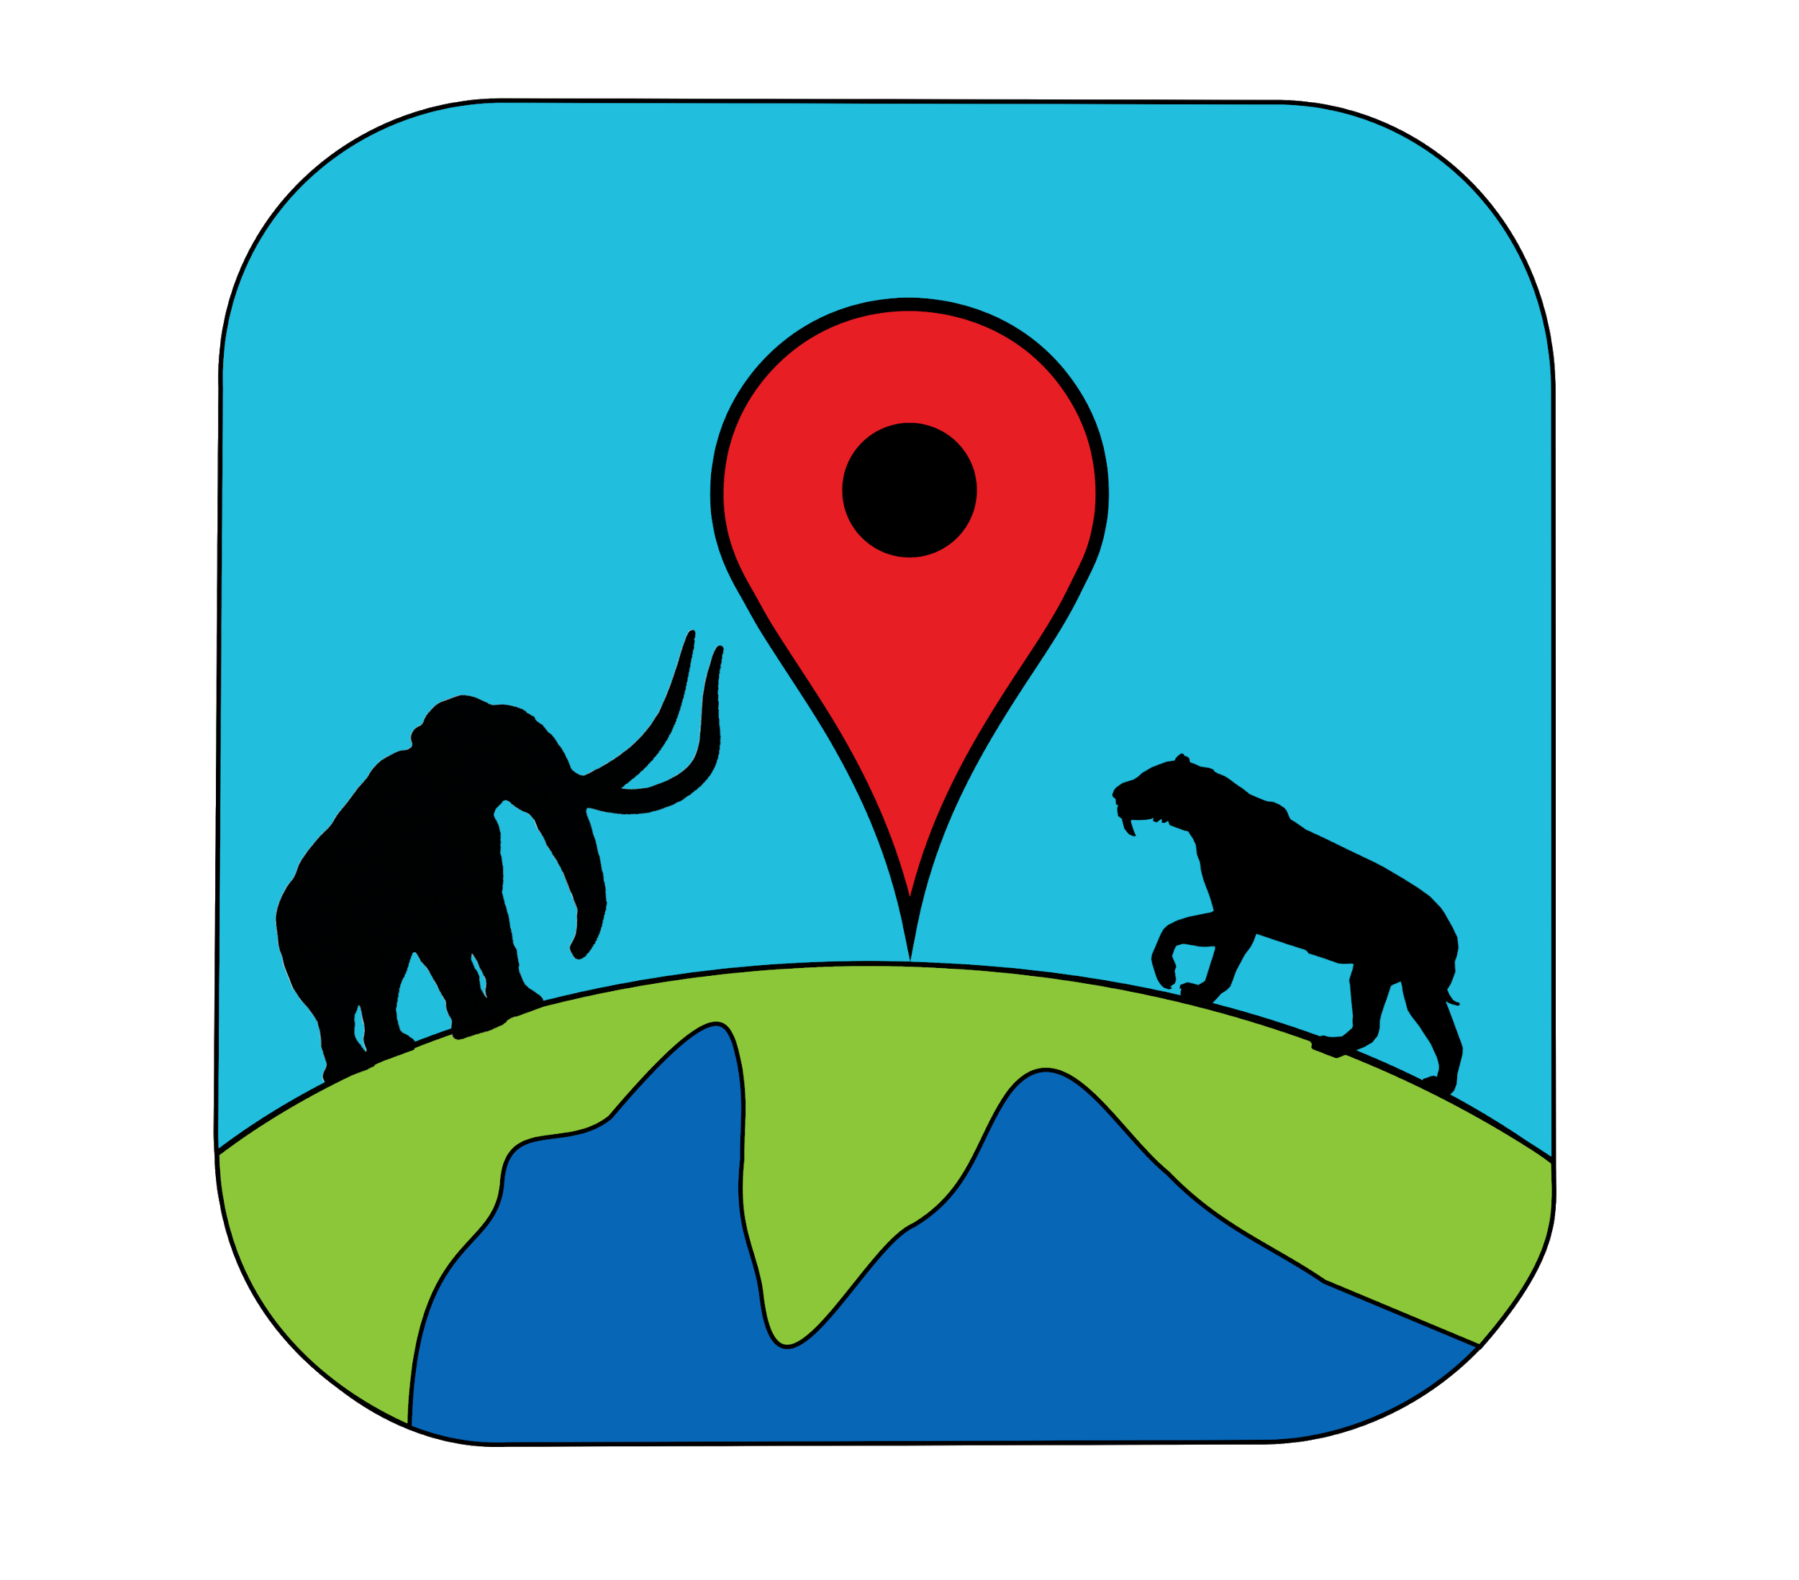
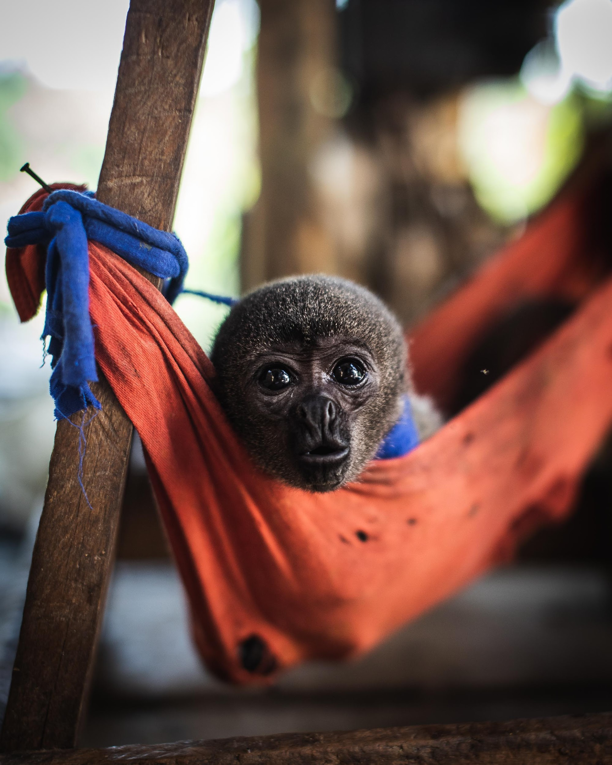
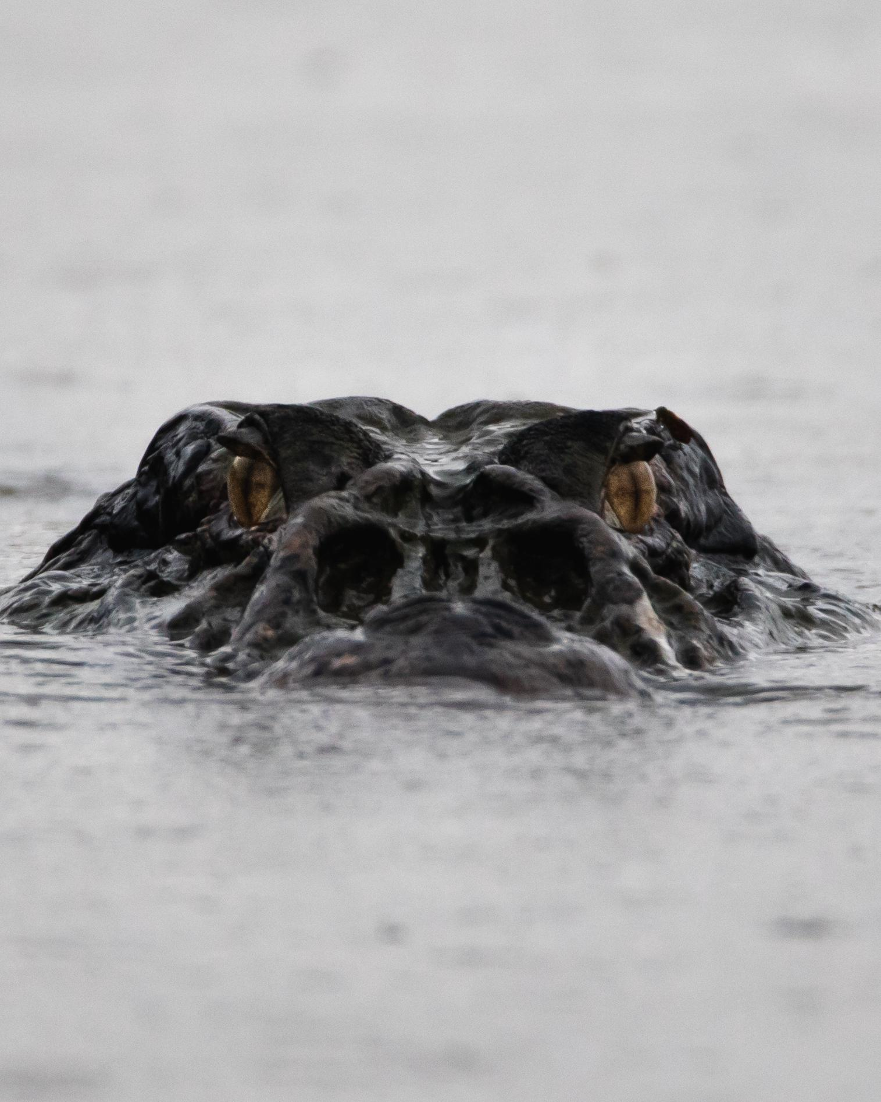
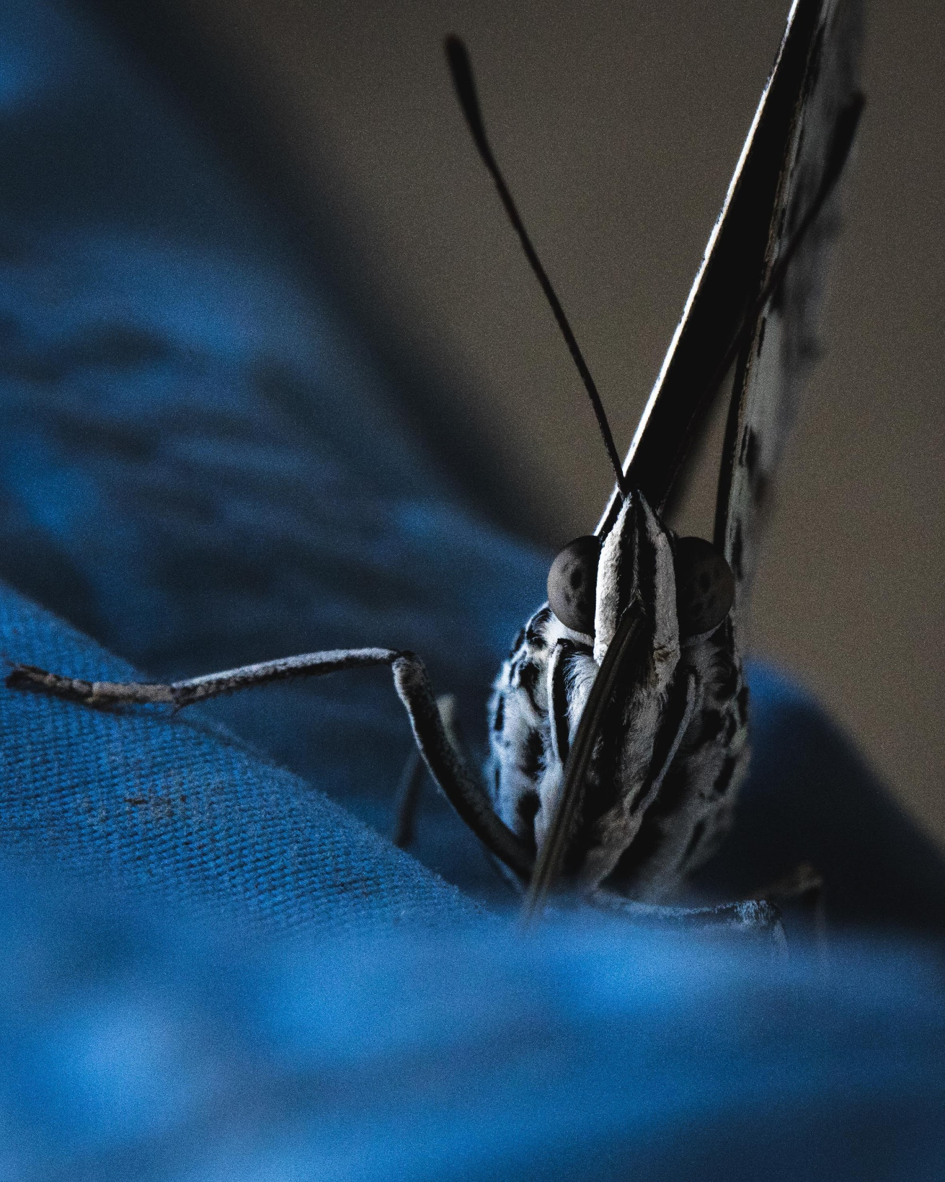
Big Animals
Big Animals
Produced for: here
Date downloaded: 24/09/2020

Slide 2
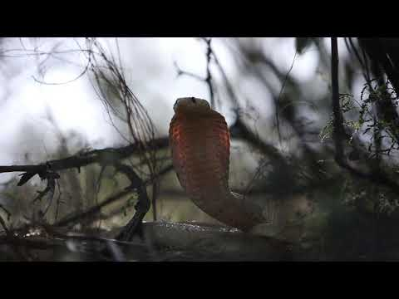

Slide 3
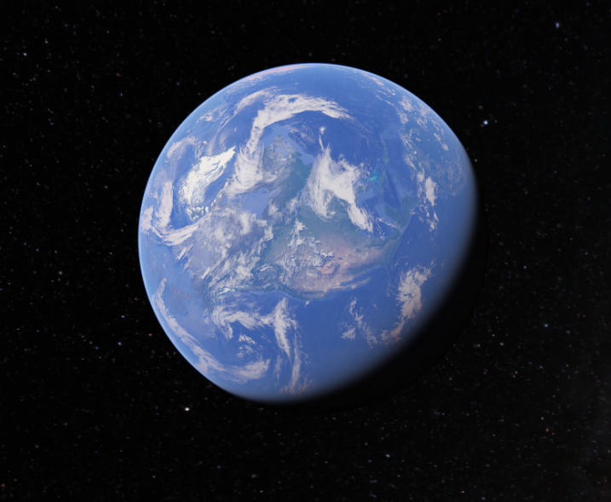
Where are you?
Click here
Notes:
This is a link to Google Earth.

Slide 4
First of all, let’s start with the largest animal in the world?
Notes:
1

Slide 5
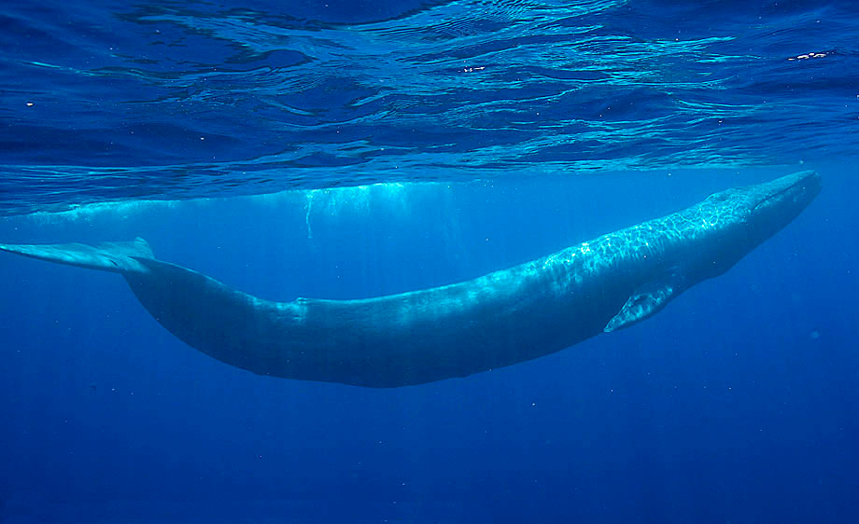
It’s the blue whale!
Notes:
1

Slide 6
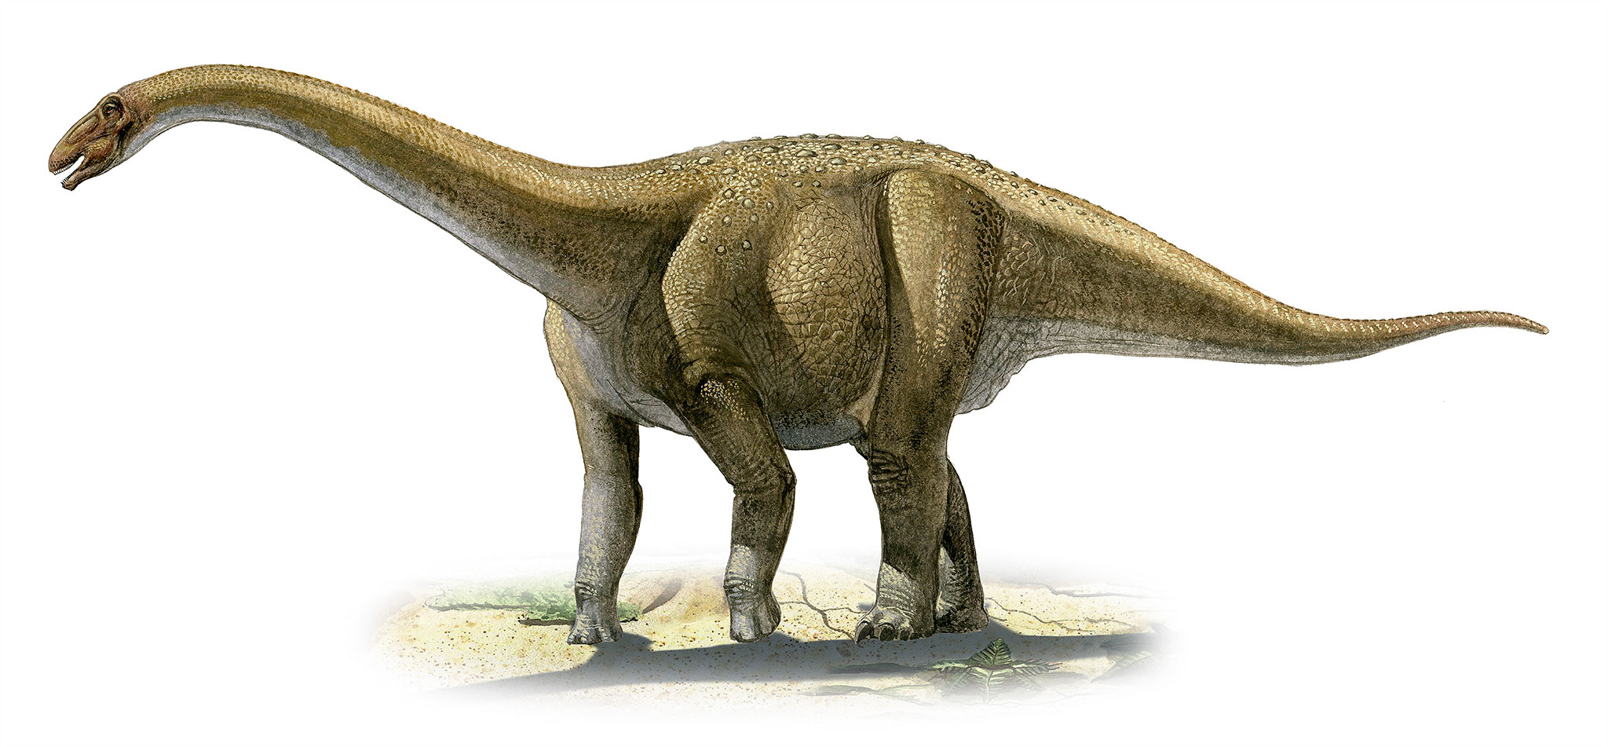
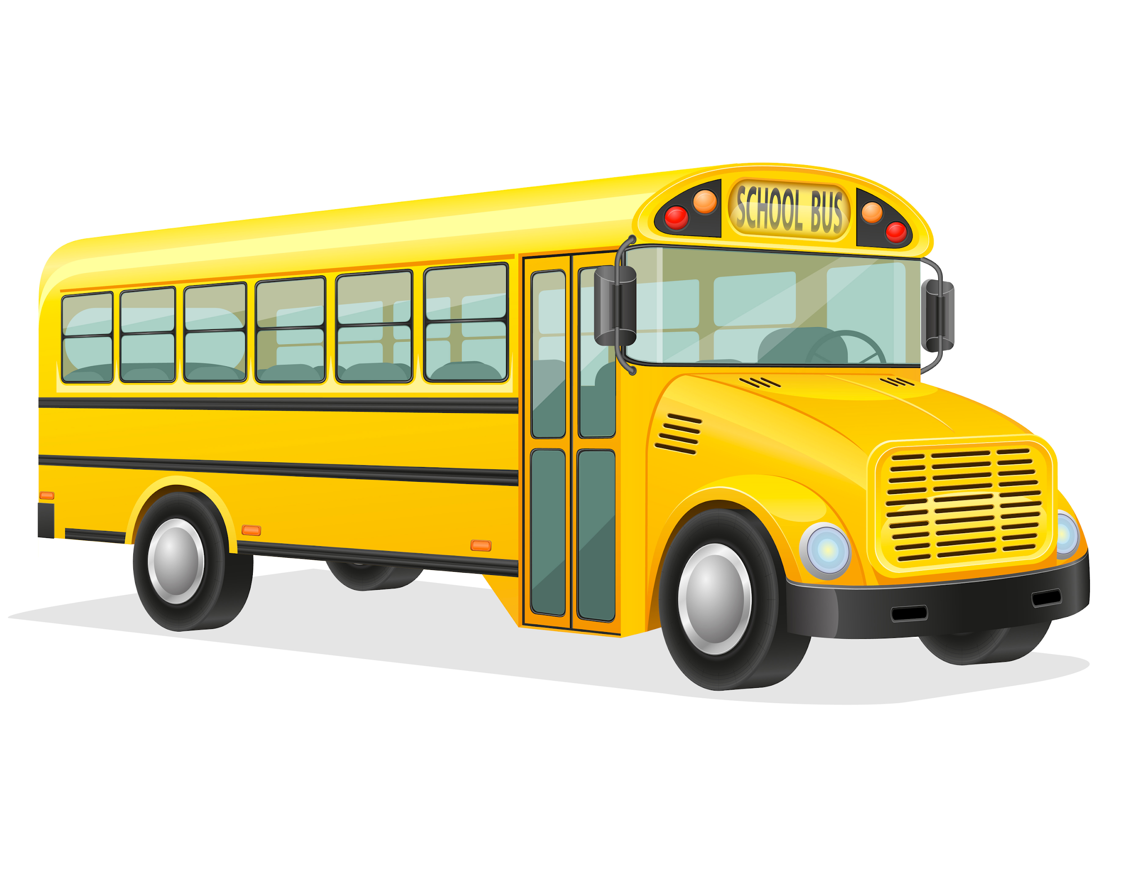
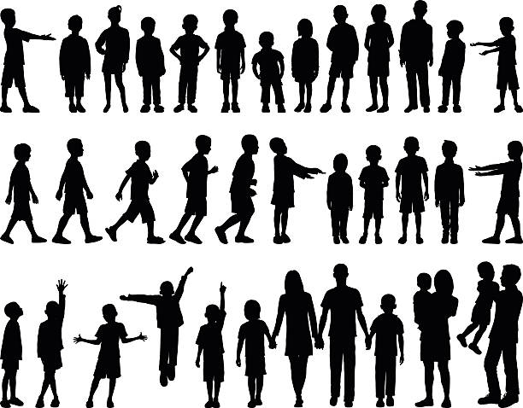
Did you know...
The blue whale is the largest animal to have ever existed, bigger even than all the dinosaurs.
A blue whale weighs the same as three school buses.
That’s equal to 4000 children!
Notes:
1

Slide 7
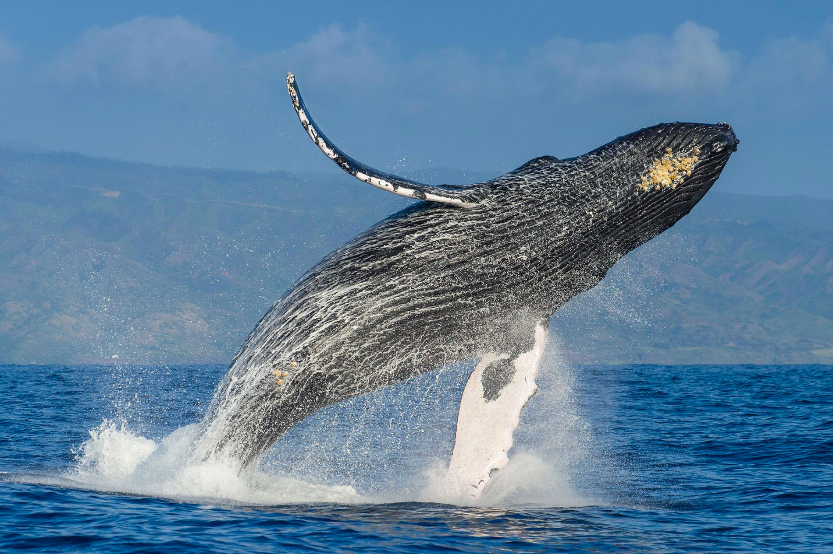

Whales can communicate over large distances with their song. You can listen here

Slide 8
Do you know what the largest animal on land is?

Slide 9
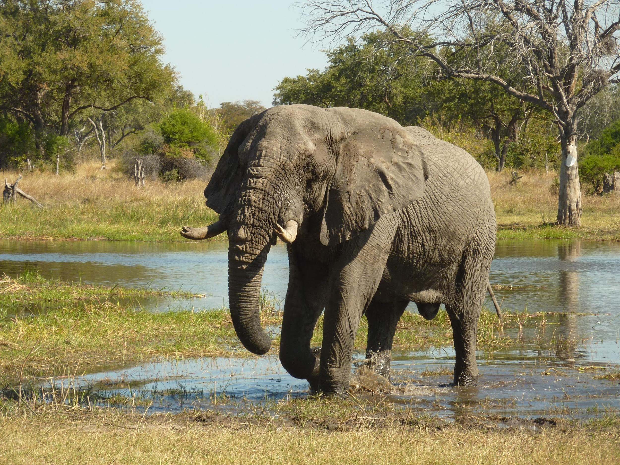
It’s the African elephant

Slide 10
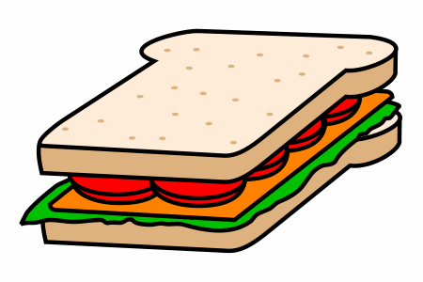
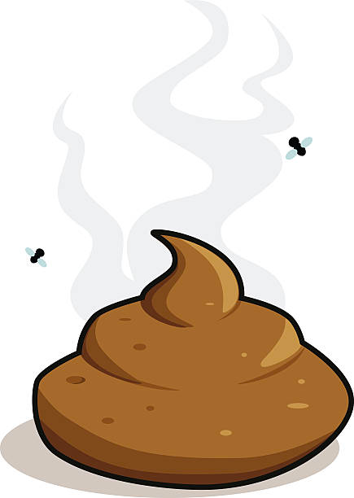
Did you know...
The African elephant can weigh over 5 tonnes, or the same as 150 children.
An African elephant can eat up to 300kg of plants per day. That’s the same weight as 600 school meals!
All that food means elephants poo...
A LOT!
Notes:
1

Slide 11
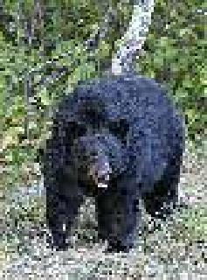
Okay, so how about the largest animal that lives near here?

Slide 12
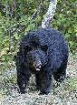

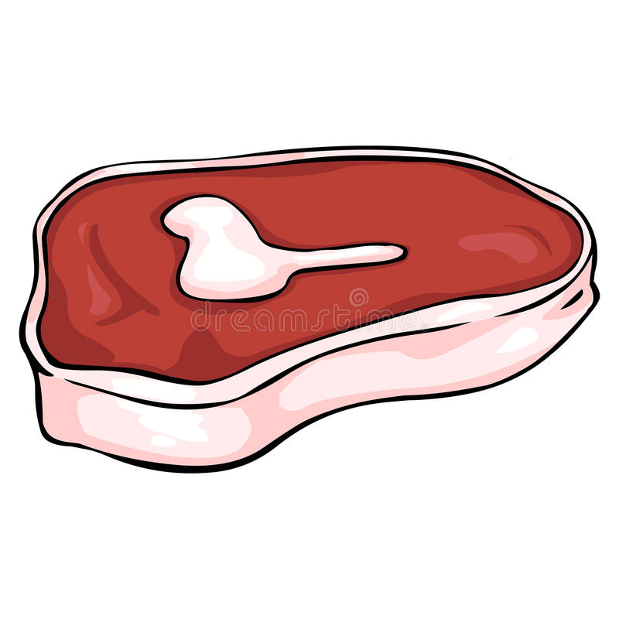
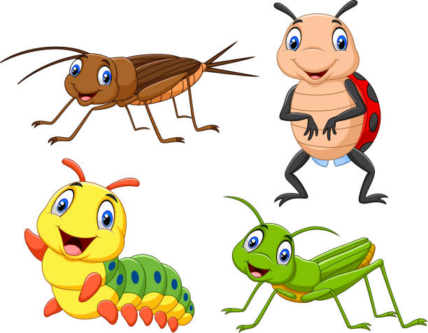
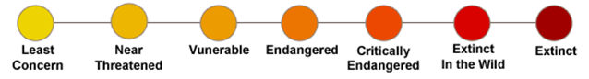
The American black bear…
Weighs in at 99.9494 kg…
And eats
87% of plant,
0% of meat,
and 13% of insects
And has an extinction threat level of Extinct.

Slide 13
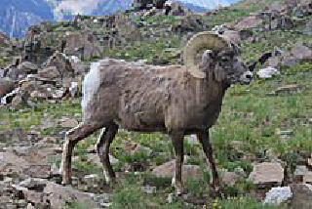
How about the second largest animal near here?

Slide 14
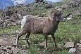
The Bighorn sheep…
Weighs in at 74.64489999999999 kg…
And eats
100% of plant,
0% of meat,
and 0% of insects
And has an extinction threat level of Extant (resident).

Slide 15
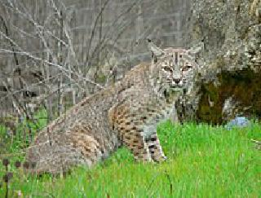
Those are some big animals! But what about the largest predator?
Note: A predator is an animal that eats other animals

Slide 16
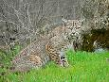
The Bobcat…
Weighs in at 8.9041 kg…
And eats
0% of plant,
100% of meat,
and 0% of insects
And has an extinction threat level of Extant (resident).

Slide 17
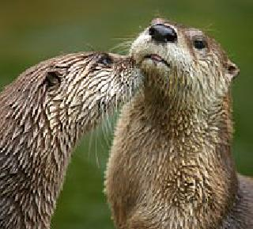
And the second largest predator?

Slide 18

The North American river otter…
Weighs in at 8.087399999999999 kg…
And eats
0% of plant,
50% of meat,
and 50% of insects
And has an extinction threat level of Extant (resident).

Slide 19
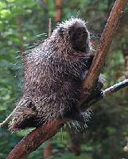
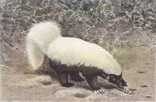
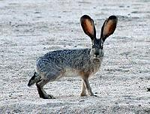
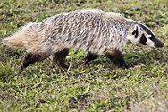
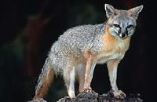
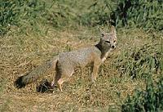
Here are some pictures of the other large animals that live near here. Can you name them?

Slide 20
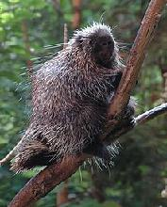
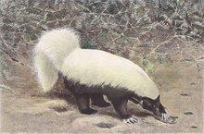

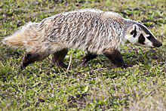
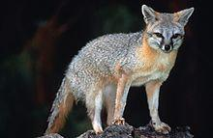

North American porcupine
Gray fox
Black-tailed jackrabbit
American badger
American hog-nosed skunk
Kit fox

Slide 21
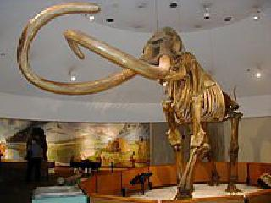
But in the past, there were many more animals that lived near here

Slide 22
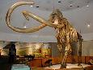
The Columbian mammoth was the largest.
This giant weighed in at 8000.0 kg and ate...
100% of plants
0% of meat
, and 0% of insects

Slide 23
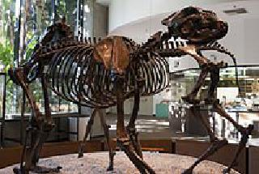
And the largest predator that is no longer here was..

Slide 24
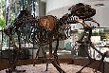
The Short-faced bear was the largest.
This giant weighed in at 720.0 kg and ate...
0% of plants
100% of meat
, and 0% of insects

Slide 25
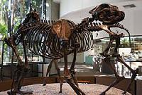

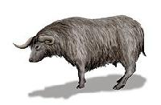
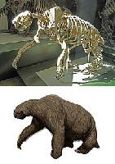
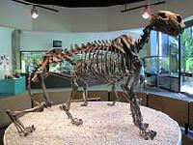
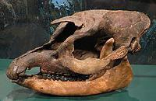
Here is a selection of animals that used to live near here

Slide 26
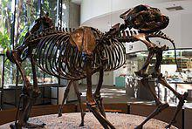

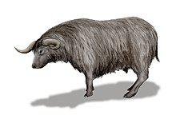

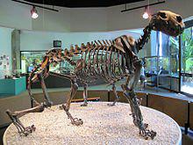

Arctodus simus
Megalonyx jeffersonii
Euceratherium collinum
Panthera atrox
Equus semiplicatus
Tapirus copei

Slide 27
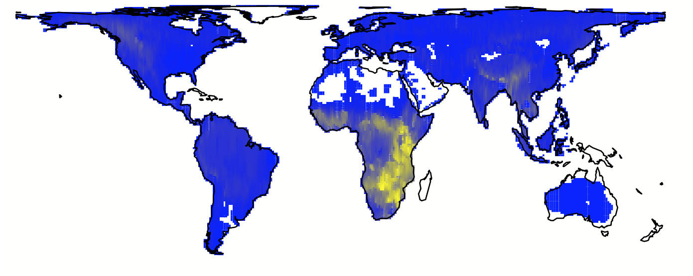
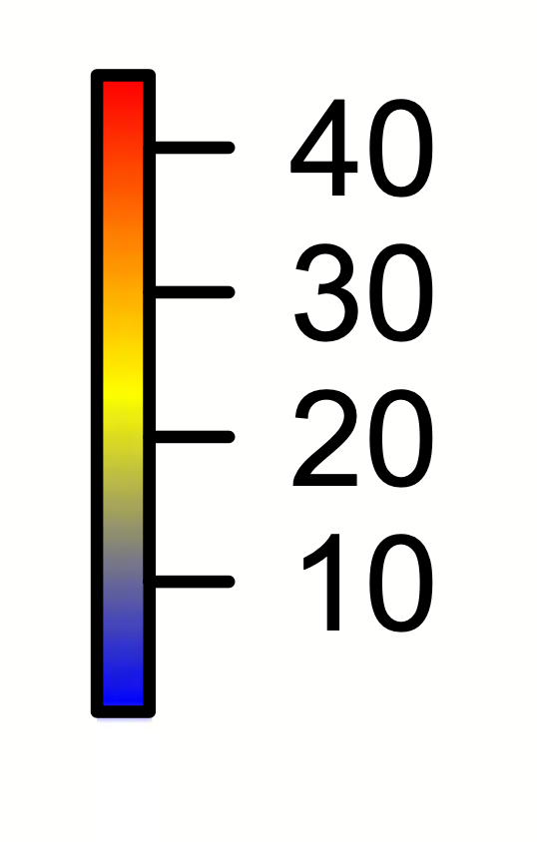
So, where do large animals live today?
The number of large animals (>44.5kg or 100lbs) living today
Notes:
1

Slide 28
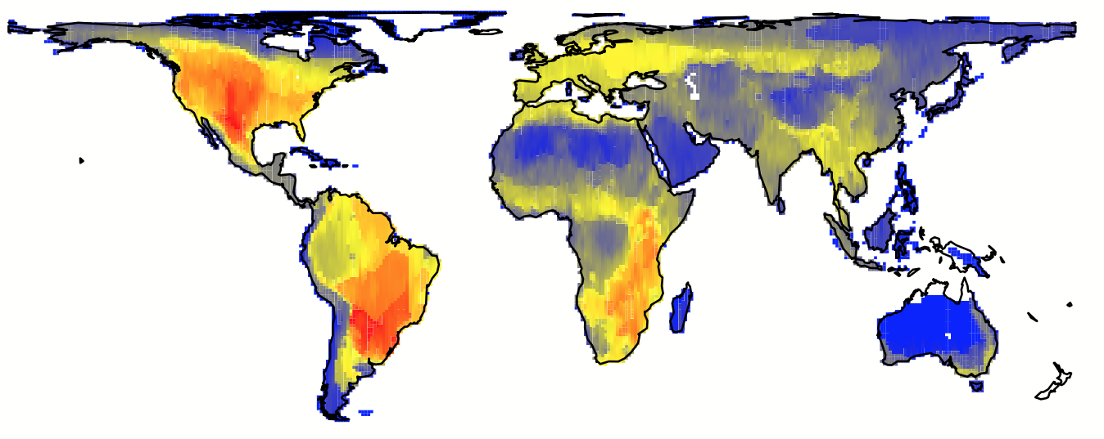
Across the whole world there were more large animals in the past
The number of large animals (>44.5kg or 100lbs) living in the past
Where did most large animals live in the past?

Slide 29
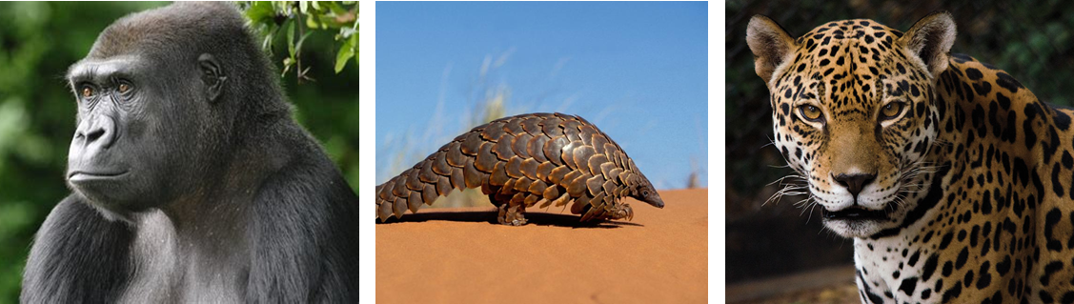
Today, the number of large animals is still falling
You can visit the WWF website here to look through a list of all large animals that are endangered

Slide 30
What things do you think you can do to help?

Slide 31
The Rules of Dobble
Each pair of cards has one matching image.
The first person to raise their hand, can answer which image is the same.
Can you think of something you’ve learned for that animal?

Slide 32










Dobble 1

Slide 33







Dobble 2

Slide 34



Dobble 3

Slide 35




Dobble 4

Slide 36

Dobble 5

Slide 37
Key learnings
There are cool animals that live near [insert school name]. But there used to be more in the past.
Big animals are important for a healthy planet.
We must protect animals for the future.

